Slide 1
Game Pigeon Clone
Brandon Butsch, Andres Carranza, Ethan Pereira

Slide 2
README and UML

Slide 3
Game Overview
Our game is based off the applications game pigeon and iMessage, which allows people to play games and text each other over a wireless connection.
Our application entails...
A server
A client
A chat service
Multiple games
Tic-Tac-Toe
Connect Four
Pool

Slide 4
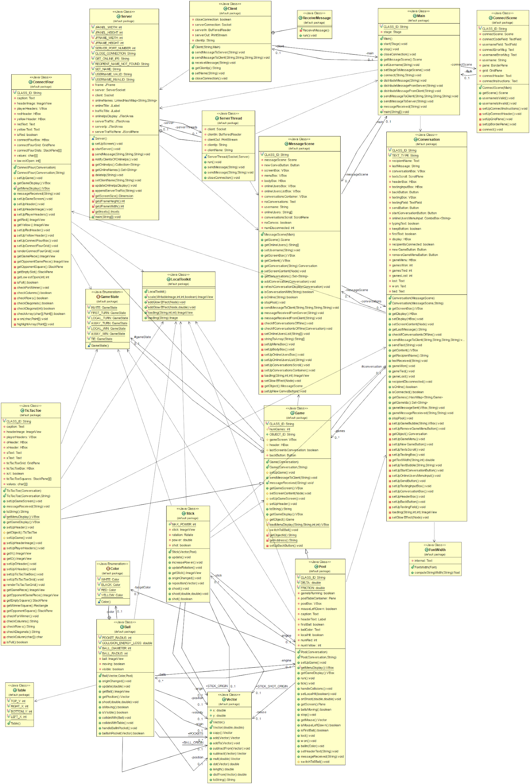
UML Diagram

Slide 5
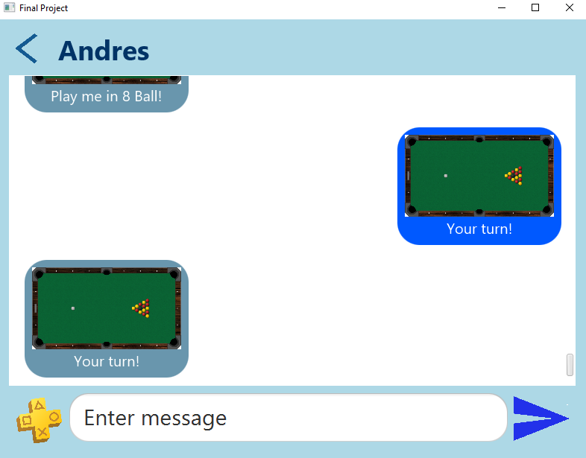
View of game while chatting in a conversation

Slide 6
Andres’ Classes

Slide 7
Main.java
This class controls everything in the program
Difficulties:
Managing encapsulation between all the classes

Slide 8
Server.java
This class relays messages from client to client
Difficulties:
Passing on information in smooth, effective manner

Slide 9
Client.java
This class communicates with other clients via the server
Difficulties:
Establishing a reliable communication protocol

Slide 10
Conversation.java
This class handles an instance of a conversation
Difficulties:
Grouping all the components of a conversation together

Slide 11
Other classes:
Ball.java: This class handles everything related to a ball in pool
ConnectScene.java: This class prompts the user to connect to the server
FontWidth.java: This class aids in creating graphics by calculating the width of a font
Game.java: This class is the parent class to all games
LocalToolkit.java: This class provides useful methods to aid other classes
MessageScene.java: This class provides the menu for creating a new conversation
Pool.java: This class controls the gameplay for a pool game
Stick.java: This class handles everything related to a stick in pool
Table.java: This class holds the coordinates for the pool table
Vector.java: This class represents a vector

Slide 12
Brandon’s Classes

Slide 13
ConnectFour.java
This class handles an instance of a connect four game
Difficulties:
Making the grid react to user input in a connect manne

Slide 14
Ethan’s Classes

Slide 15
TicTacToe.java
This class handles an instance of a Tic-Tac-Toe game
Difficulties:
Checking for a winner

Slide 16
Reflection
Positives:
In the end we were really happy with how the game turned out
Next Steps:
Implement more games
Make the UI more user-friendly
Tune existing games

